Slide 1
The importance of interaction networks in long-term care facilities (LTCFs) to
reduce the equilibrium prevalence of infectious pathogens
Matthew Samore
Karim Khader, Kyle Kazemini, Nelson Chang, Lindsay Visnovsky, Alun Thomas, Candace Haroldsen, Kristina Stratford, Chong Zhang, and George Vega Yon
University of Utah
VA Salt Lake City Health Care System
XLII INTERNATIONAL SOCIAL NETWORKS CONFERENCE
CAIRNS, AUSTRALIA

Slide 2


Transmission of pathogens in LTCFs
LTCF residents experience high rates of infection due to antibiotic resistant bacteria (such as carbapenem-resistant Gram negative rods)
Especially long-term acute care hospitals (LTACHs) and ventilator-capable skilled nursing facilities (vSNFs)
And high incidence of infection and death due to SARS-CoV-2
Questions that motivated this study:
What is the impact of network structure?
Which network interventions may reduce transmission

Slide 3
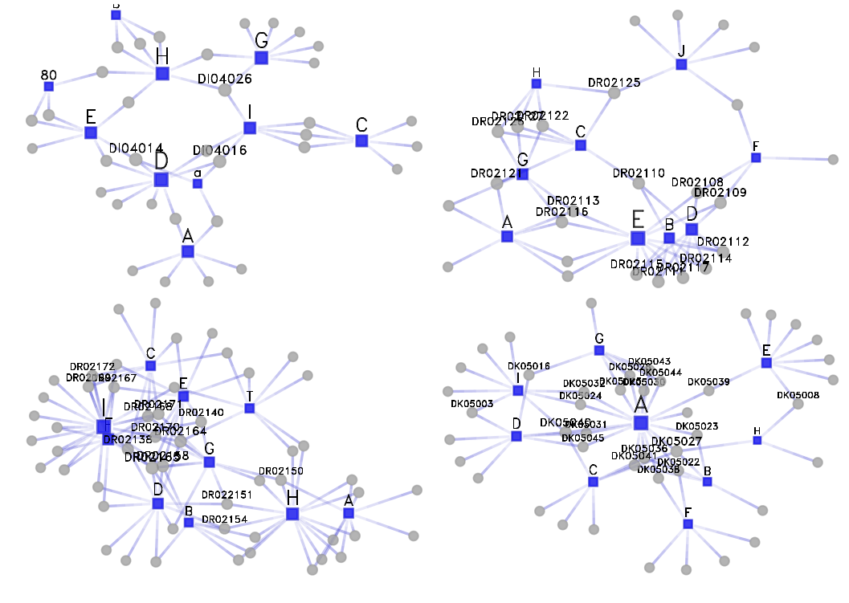
Collected data
Surveyed 25 Long-term Healthcare Facilities.
7 types of healthcare workers (nurse assistants, nurses, physicians, physical therapists/occupational therapists)
Residents under various types of care/health conditions:
Ventilator
Wound care
Dialysis
Diabetes
etc.
A tie: Health Care Worker (HCW) interacts with Resident.
Descriptive Stats:
Mean degree resident: 2.3
Mean degree HCW: 9.3
Grand total:
4191 vertices
836 HCW (actors in bi-partite graph)
7811 edges
100 bi-partite networks
Each graph is {facility x unit x day}

Slide 4

Analysis plan
Multi-level bi-partite exponential random graph models (ERGMs): what is the structure of HCW-resident networks?
Pooled ERGMs
Much of work based on Krivitsky et al. (2022, arXiv).
Agent-Based Models (ABMs): run forward simulations to evaluate which features of real-world networks matter
Used epiworld: https://github.com/UofUEpi/epiworld
Ran three sets of experiments changing the network.
Notes:
- Multilevel (as in pooled) ERGM are becoming more common.
- Nonetheless, flexiblity and methods for dealing with more complex hypotheses, e.g., interaction effects and controling for network-level features, is rather recent.
- Krivitsky et. Al. (2022), toghether with ERGM 4 and the new R package ergm.multi, have introduced important advancements and tools to deal with this type of data.
- Here we go a bit further, leveraging the new ERGM operators, we fit pooled ERGMs with bipartite graphs.
- In the case of ABM, we are using a new C++ library we developed at the U. Bottom line of this ABM framework is that we can propotype and run models very fast.
- Right now, we wanted to start assessing how important is the graph structure.

Slide 5
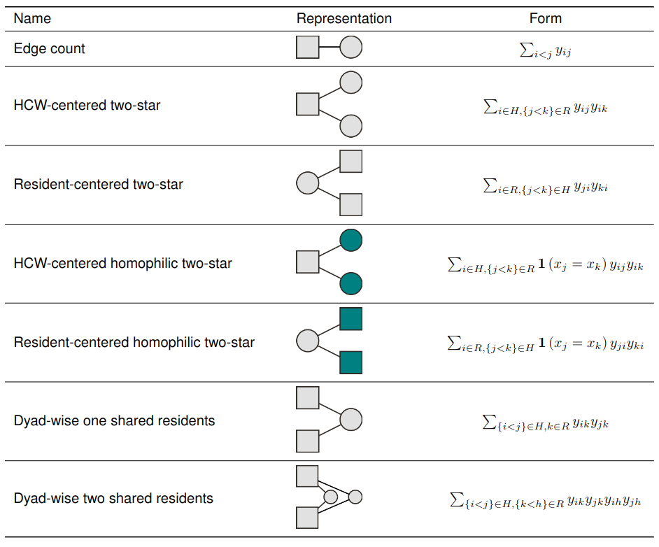

Plan: ERGMs
Pooled ERGMs (block-diagonal model)
Bi-partite graphs
Used ergm 4.0’s operators to evaluate other terms, e.g., HCW-centered homophilic two-star adjusted by .
Post-estimation analyses looking at studentized-errors.
Still work-in-progress.
Notes:
HCW attribute: Type of HCW

Slide 6
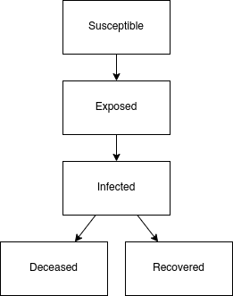
Plan: Agent-Based Model
SEIRD: Susceptible-Exposed-Infected-Recovered-Deceased
(*) Three sets of 1,000 simulations {ERGM, Deg. Seq., Bernoulli}.
One infected not on ventilator.
Residents on ventilator have:
Lower recovery rate
Higher mortality rate
Simulated 120 days.
(*): Deg. Seq. and Bernoulli were generated by rewiring the ERGM
Notes:
- We used the estimates of the fitter ERGM model to simulate the set of 100 networks.
- For each ERGM simulated graph, we then rewired the network in two ways: preserving the degree sequence and completely rewiring the graph, a bernoulli graph.
- We repeated the procedure 1,000 times, totaling 3,000 random graphs.
- For each graph, we simulated an outbreak with an SEIRD model for 120.
- Finally, we compared the epi curves, the death curve under each set of models.
- This is just a first pass, next plan we will vary simulation parameters and regress simulation outcomes against results.

Slide 7
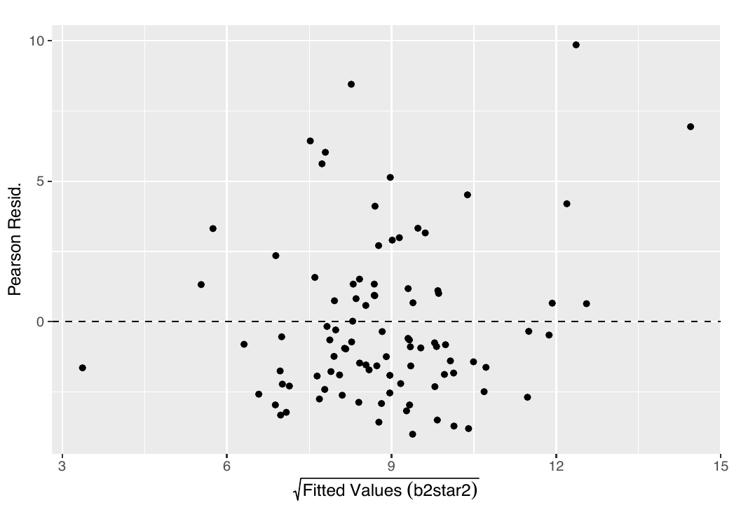
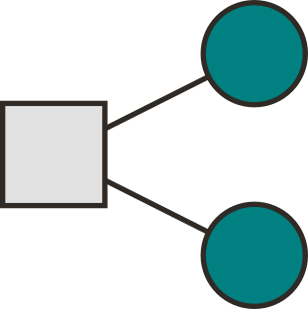
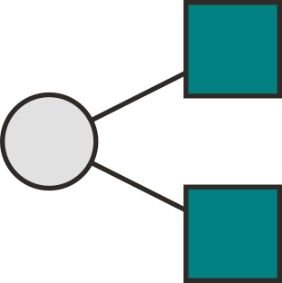
Preliminary results: ERGM
Resident centered:
(-) two-star
(+) two-star mixing on Nurse
(-) two-star mixing on PT/OT
(-) two-star mixing on RT
Health Care Worker centered
(+) two-start mixing: Race.
(+) two-start mixing: diabetes, wheelchair, MDRO, and ventilator.
(-) two-start mixing: wound care, dialysis, bedridden.
Other significant effects:
(-) Health Care Worker dyad-wise shared one and two partners.
(-) Covariate effect on sqrt(resident age).
(+) Edge count and (-) Edge count x log(n)
Notes:
- So far, we have not found significant differences across HC facilities.
- Edge-count adjusted by network size shows a significant effect.
- For post-estimation, we are following Krivitstky and others (2022) for inspecting the results.
- We also use linear regressions to assess the benefit of incorporating other ERGM terms before actually running the ERGM (George can explain more about it.)

Slide 8
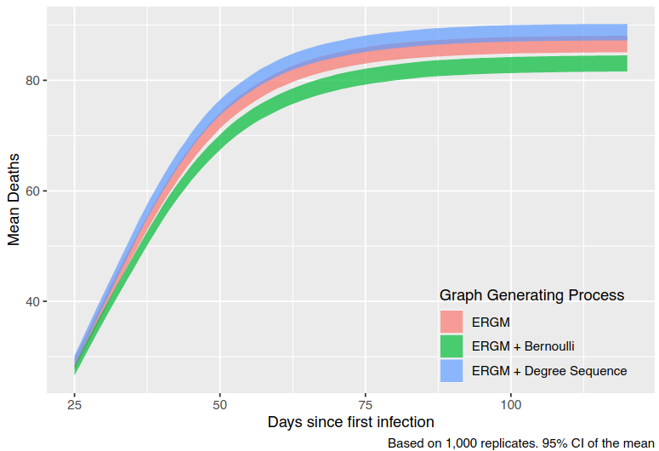
Preliminary results: ABM
Death curve as a function of the network:
Used fitted ERGM from real data.
ERGM taken as a baseline, then rewire.
Statistically significant differences in the average number of deaths.
ERGMs are specially useful when network data is not available!
We can use ERGMs as a Data Generating Process for Arbitrary studies.
Notes:
- Again, we took one of the fitted models and use that as a data-generating process [DGP].
- The figure shows the average number of deaths per DGP across the 1,000 replicates.
- It is apparent from the figure that network structure can result in significantly different results, from the statistical point of view.
- Nonetheless, this is merely a simple exercise compared to what we can do, which is run large simulation studies under different network treatments and assess what components of the different scenarios as the strongest effect on the simulation outcomes. This is of real value for policy making process.
- It is worthwhile pointing that the set of 3,000 simulation experiments took less than 30 seconds.

Slide 9
Discussion and Next steps
Today:
We fitted a Bi-partite pooled ERGM.
ERGM can be used as a Data-Generating-Process.
Demonstrated that the network matters (mixing on health status impacts death rates).
Next steps:
Still work in progress, new ways to asses GOF.
Share our results for generating artificial networks.

Slide 10

Acknowledgments:
Funded by Centers for Disease Control and Prevention (CDC) through the Prevention Epicenters (grant number U01CK000555-01-00
Collaboration with CDC Emerging Infections Program (EIP)
Site Principal Investigators:
Morgan Katz, Mary-Claire Roghmann, Philip Polgreen, Scott Fridkin

Slide 11
The importance of interaction networks in long-term care facilities to
reduce the equilibrium prevalence of infectious pathogens
Thank you!
Matthew Samore
Karim Khader, Kyle Kazemini, Nelson Chang, Lindsay Visnovsky, Alun Thomas, Candace Haroldsen, Kristina Stratford, Chong Zhang, and George Vega Yon
XLII INTERNATIONAL SOCIAL NETWORKS CONFERENCE
CAIRNS, AUSTRALIA

Slide 12
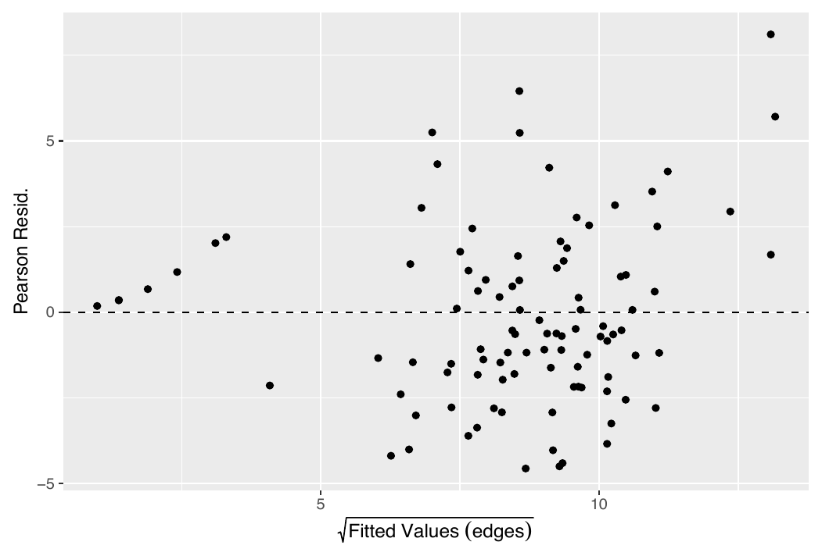
Appendix: Post-estimation analyses

Slide 13
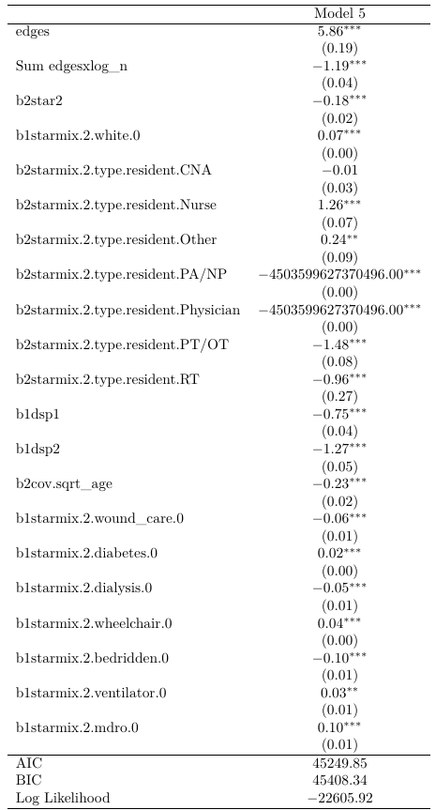
Appendix: ERGM estimates
We have tried various setups.
Effects interacting with the log(n) and log(n)^2 were not significant.
The ERGM specification has:
Bi-partite graph, and
Block-diagonal constrain
We have functions to assess GOF using residual analysis.
Still work in progress.

